Slide 1
DOM Manipulation
Front-End Web Development

Slide 2
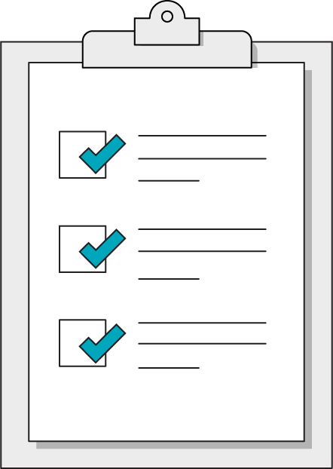
Today’s Learning Objectives
In this lesson, you will:
Identify the role of JavaScript in front-end web development.
Access properties of the DOM using JavaScript object syntax.
Use DOM methods to respond to user actions with event listeners.
‹#› | © 2020 General Assembly

Slide 3

What Is JS?
15 minutes
Now that we’ve met all three front-end technologies, what exactly does JavaScript do for us? How do HTML, CSS, and JS intersect?
Draw a Venn diagram illustrating the roles of each technology and where they intersect.

Slide 4
Conditionals
Front-End Web Development

Slide 5
Making Decisions
It's either TRUE or FALSE (like booleans)
If you are greater than 18 you are an adult
if (age > 18) {
document.write("You are an adult");
}

Slide 6
Testing Equality
10 === 10 //true
10 === 5 //false
"hi" === "hi" //true

Slide 7
Comparison Syntax
if(condition is true) {
//Do cool stuff
}

Slide 8
Comparison Syntax
if(condition is true) {
//Do cool stuff
}else{ //Do different cool stuff }

Slide 9
Multiple Conditions
if (name == "GA" && password == "Pencil"){
//Allow access to internet
}

Slide 10
Multiple Conditions
if (day == "mon" || day == "wed"){
//We Have Class Today
}

Slide 11
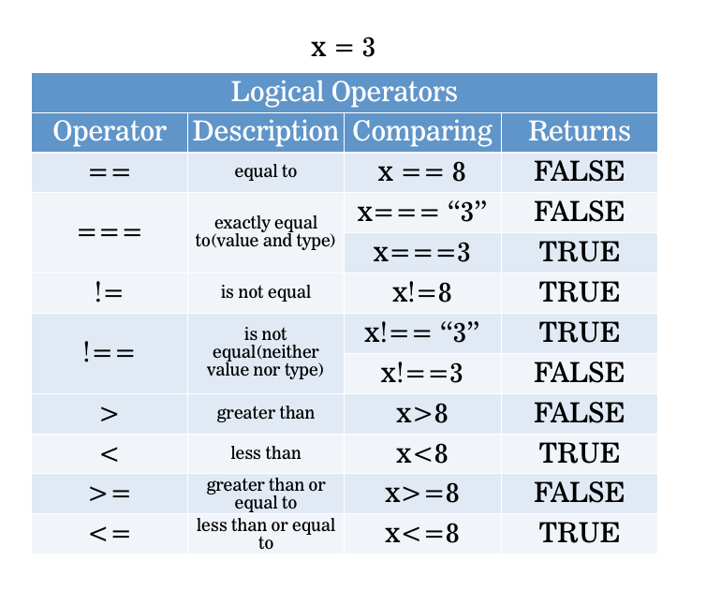
Making Decisions
Remember:
= assigns == tests equivalence === tests equivalence + type

Slide 12
Compare That
Let’s see how we can attach event listeners by grabbing elements with either class or ID selectors.
Starter code:
https://drive.google.com/drive/folders/1wBGy9rEoKAyIvKVEZ4NiSlc4VW5fJQ7U?usp=sharing
Solution code:
https://drive.google.com/drive/folders/1wBGy9rEoKAyIvKVEZ4NiSlc4VW5fJQ7U?usp=sharing

Slide 13
Most JavaScript is the combination of two concepts: What and When
‹#› | © 2020 General Assembly

Slide 14
The What: The Webpage Object
Front-End Web Development

Slide 15
A Webpage Is One Giant JS Object
Window
Document
Console

Slide 16
Everything you see in the browser is a
JS object.
‹#› | © 2020 General Assembly

Slide 17
Three Big Objects
Window
Document
Console
The whole web browser; mostly used for browser-level settings.
The current webpage. This object has the functionality we want to use when accessing elements on the page.
A scratch pad for development-related messages; highly useful in debugging.

Slide 18

The DOM
Browsers read your HTML and create an object in the computer’s memory for each part. That HTML layout is called a “data model” because it describes the structure of your webpage.
The Document Object Model (DOM) is the browser’s JavaScript representation of your HTML elements.

Slide 19
Getters and Setters
The main thing we’re doing with JS is getting objects from the DOM and performing actions with them (moving, hiding, etc).
The methods that get something from a webpage are called getters.
The methods that change something on the webpage are called setters.

Slide 20
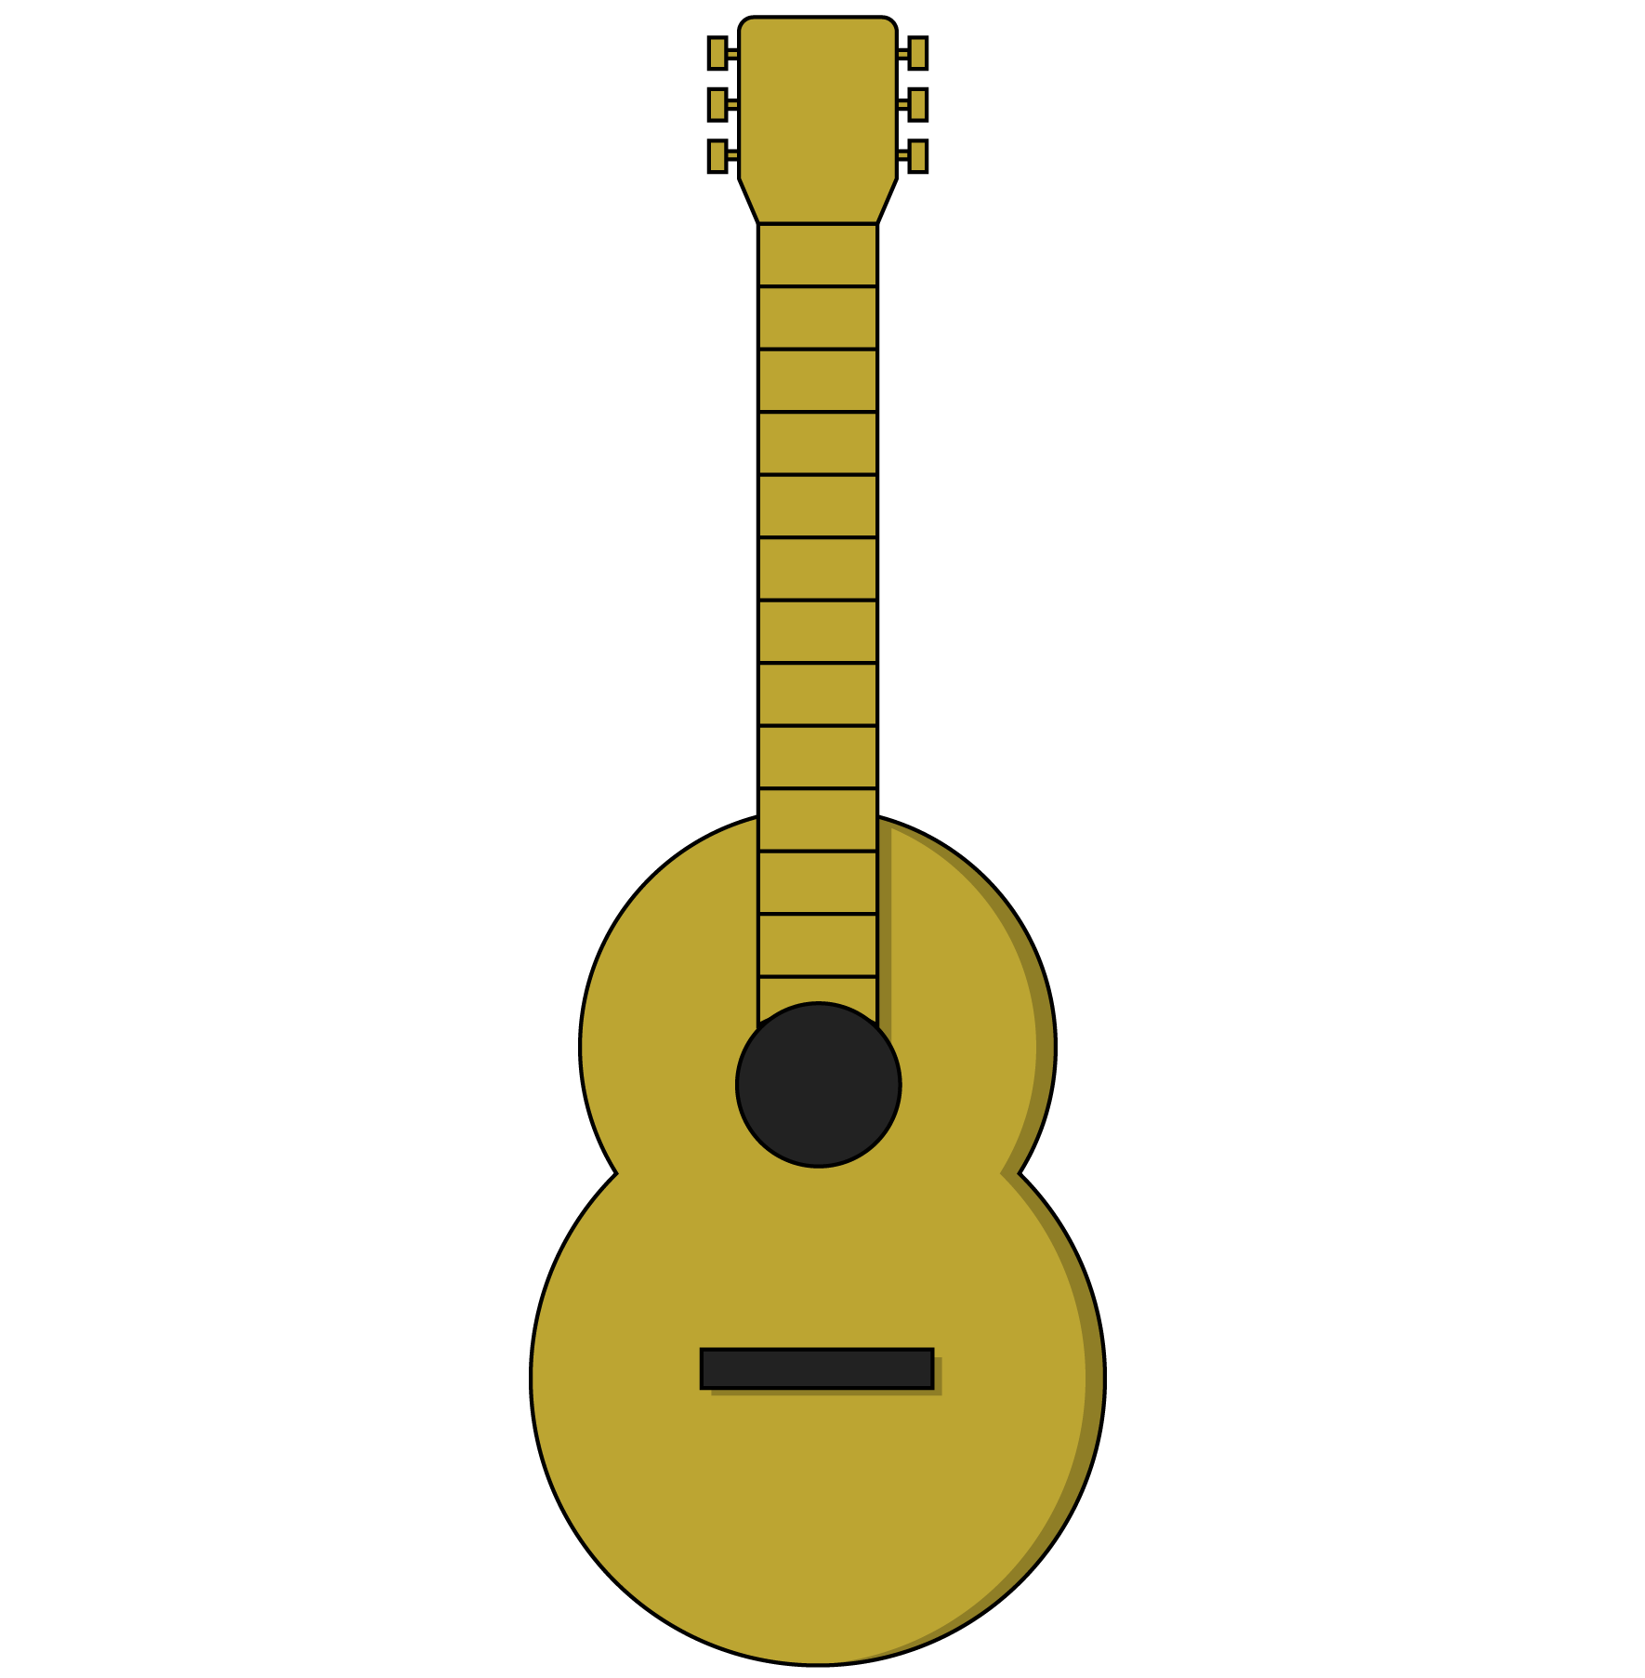
Methods
Getters and setters access and modify objects. They are both types of methods. Methods belong to JavaScript objects, including DOM elements.
Think of methods as the functions that an object can use. A guitar, for example, might have the following methods:
guitar.playChord(chord)
guitar.playNote(note)
guitar.changeTempo(tempo)
guitar.changeVolume(volume)

Slide 21
Properties
Objects often have metadata — information that describes the object (height, width, classes, etc). These pieces of information are called properties.
Property | Description
someElement.classList | A list of the classes belonging to a DOM element.
someElement.id | The ID of an element, if it has one.
someElement.style.color | The color of an element’s text.
window.location.href | The window object’s location details, including the page’s href (hypertext reference/URL).

Slide 22
What Does a Real Piece of Code Look Like?
document.getElementById(‘ga’);
Object
Method (getter)
Parameter

Slide 23
Getters
Getters often fill in variables in your JS. Once you get something from the DOM, you can use a variable to store it in memory for future manipulation.
const gaData = document.getElementById(‘ga’);
Now that we have our element, gaData, we can access its properties:
gaData.style.color;
gaData.innerText;
gaData.classList;

Slide 24
We’re mostly going to manipulate classes to make things happen on our pages.
‹#› | © 2020 General Assembly

Slide 25
Manipulating an Element’s Classes
gaData.classList.toggle(‘show’);
Object
Property
Parameter
Method (setter)
This statement takes the ga object, looks at the element’s list of classes, and toggles the show class on or off.

Slide 26
DOM Reference Code
Let’s look at some DOM properties and methods in action! There’s no need to feel overwhelmed by details — the patterns are what matter.
Reference code:
https://drive.google.com/drive/folders/1DcHwmAhyWSrlAbL3vs0kgjvr3TZd75od?usp=sharing
‹#› | © 2020 General Assembly

Slide 27
The When: Event Handling
Front-End Web Development

Slide 28
Events and Listeners
Anytime a user interacts with a webpage, the browser classifies that action as an event.
In our JS code, we can listen for events in the browser and trigger functions in response using event listeners.
// When object is clicked, the action function is called object.addEventListener(‘click’, action)

Slide 29
Get, Then Listen
We’ll often get an element and then set an event listener on it. Once the event occurs, the listener will execute the function it was given.
const ga = document.getElementById(‘ga’);
function sayHello(){ console.log(“hello!”);
} ga.addEventListener(‘click’, sayHello)

Slide 30

Events to Listen For
Click is the most common, but what other events might we want to listen for?

Slide 31
Event Listeners With Selectors
Let’s see how we can attach event listeners by grabbing elements with either class or ID selectors.
Code with class selectors:
https://drive.google.com/drive/folders/1mm1rkPgnUzgDD-NsIHy4lQU-8jCyn9Bb?usp=sharing
Code with ID selectors:
https://drive.google.com/drive/folders/1QiTumxSp4joe6-y93PvTsAx0_xD8G4gv?usp=sharing

Slide 32
Color Switcher
30 minutes
In this exercise, we’ll use our new event-listening skills to create a color switcher!
Bonus: Try adding more switcher elements that change more colors.
Starter code:
https://drive.google.com/drive/folders/1ekSei8Da5QdZRP9iabhoLzYMYYxpiBOL?usp=sharing
Solution code:
https://drive.google.com/drive/folders/1czuJ8b5gjWcC8byLrsaP3_G_0ljtLtbM?usp=sharing

Slide 33
Traffic Light
45 minutes
In this exercise, write JavaScript that uses buttons to control the traffic light. Only ONE color should be active at a time!
Starter code:
https://drive.google.com/drive/folders/1QkYpHVmIRTsHN5zQ_FKr4m3iuum3Jmhp?usp=sharing
Solution code:
https://drive.google.com/drive/folders/1OvbdYhbT93XUGEsOxWyTDCVegC9z2YHJ?usp=sharing

Slide 34
Key Takeaways
For Next Time
Everything Is JavaScript!
JavaScript Practice!
HTML elements are represented as objects in the DOM.
DOM objects have getters and setters to manipulate properties.
Event listeners attach to objects and use functions to respond to user actions.
We learned a lot of new concepts in this lesson. Next time, we’ll put them into practice.
‹#› | © 2020 General Assembly

